Slide 2
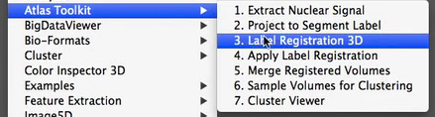
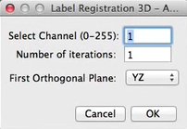
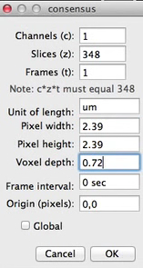
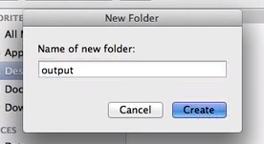

Slide 3
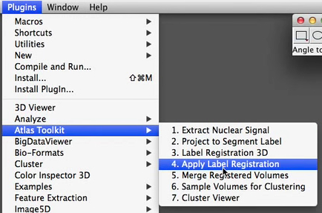
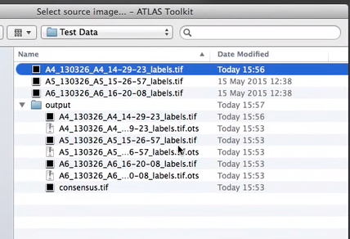
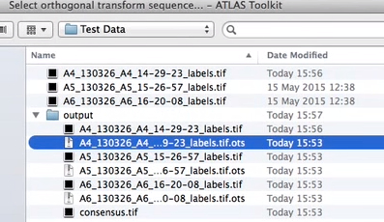
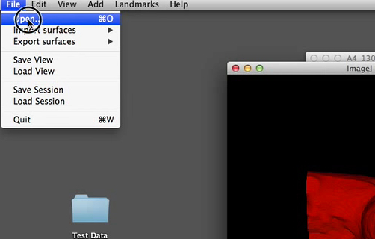
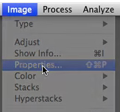
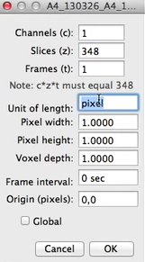
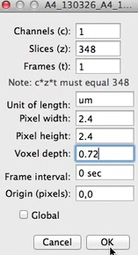
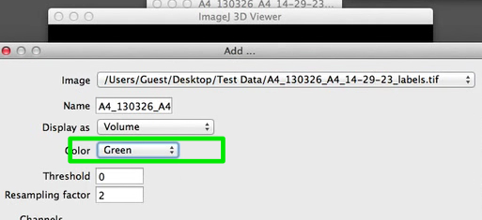

Slide 5
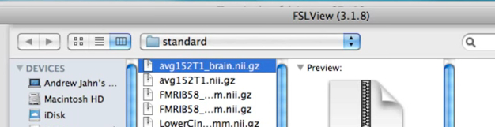
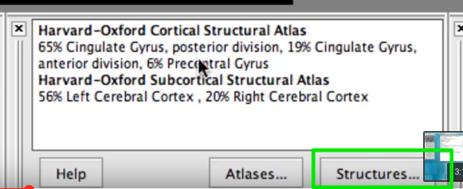
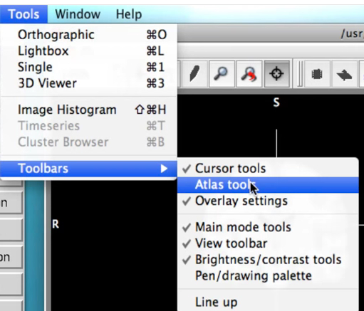
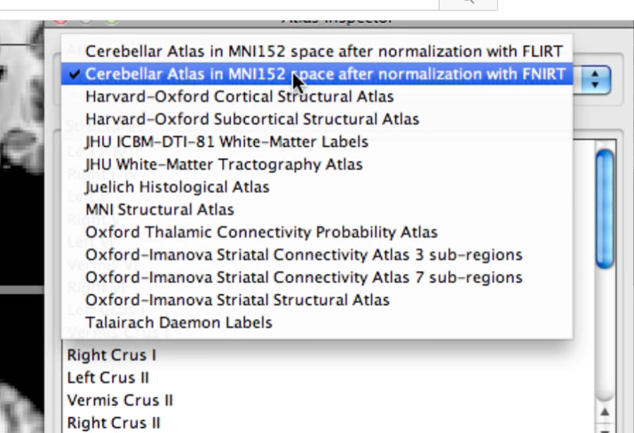
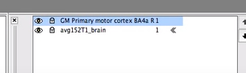
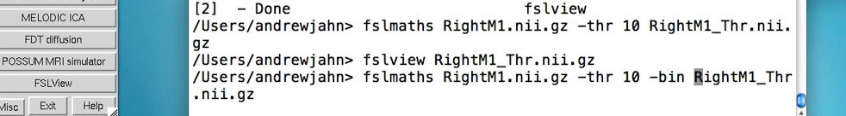
https://www.youtube.com/watch?v=fIu4tUjRfUE

Slide 6
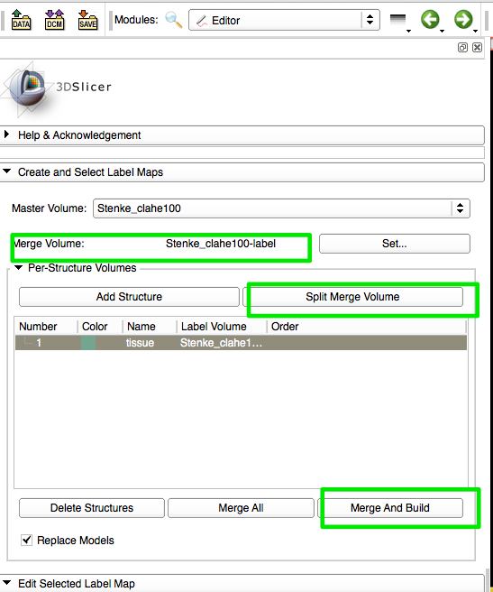
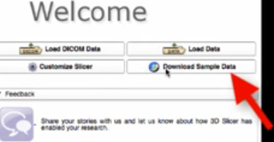

Slide 7
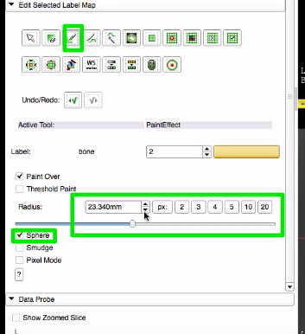
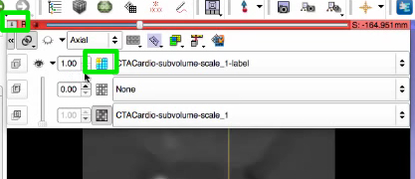
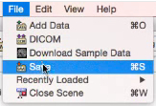
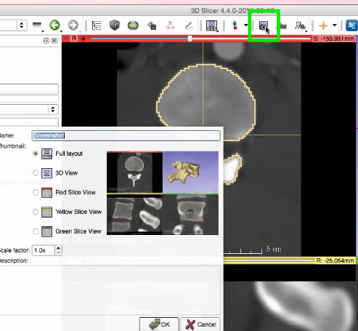

Slide 8
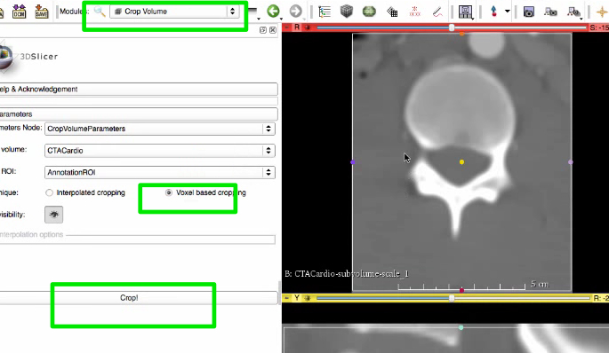
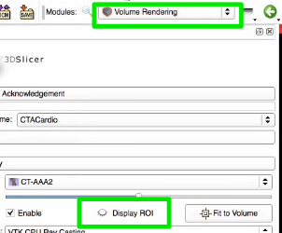
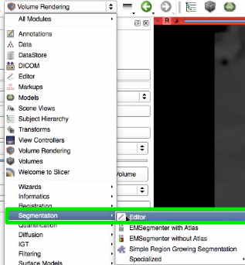
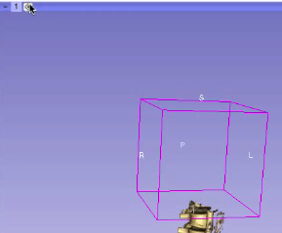
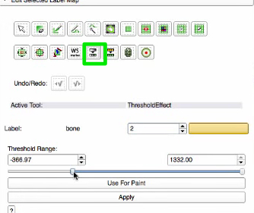

Slide 10
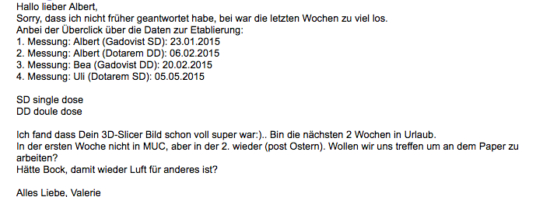
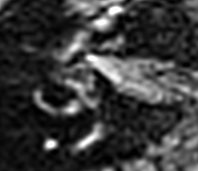
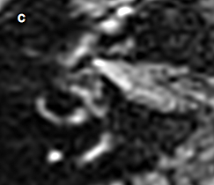
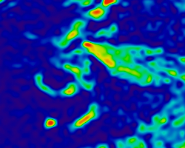


Slide 11
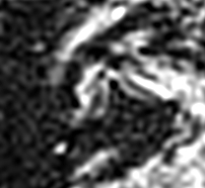
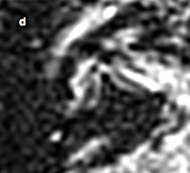
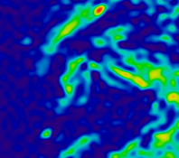


Slide 12
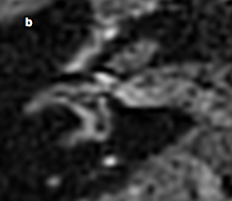
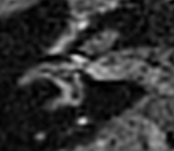
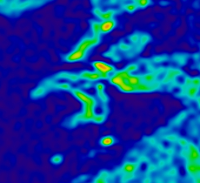


Slide 13
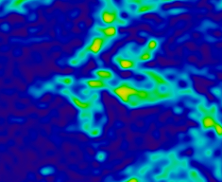
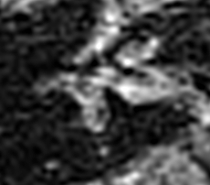

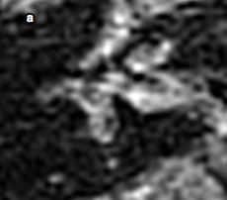

Slide 14



Slide 15
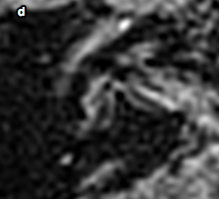

Slide 16
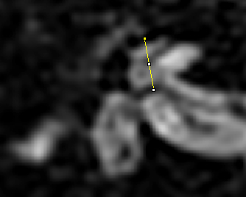
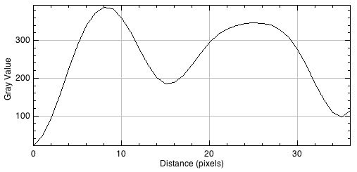
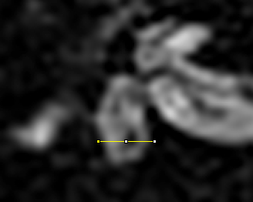
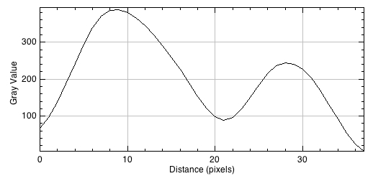

Slide 17
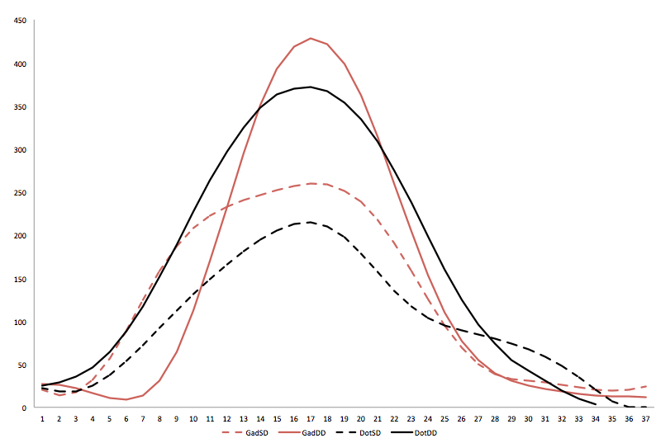

Slide 18
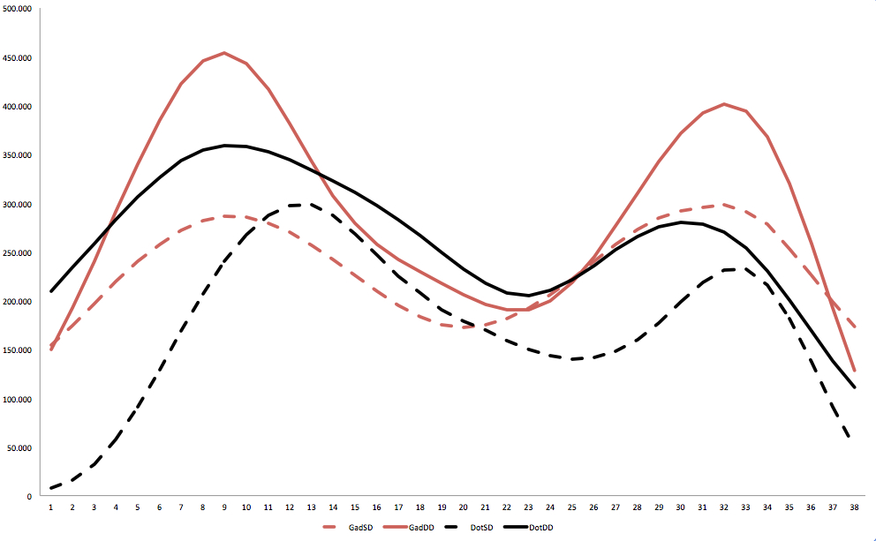

Slide 19
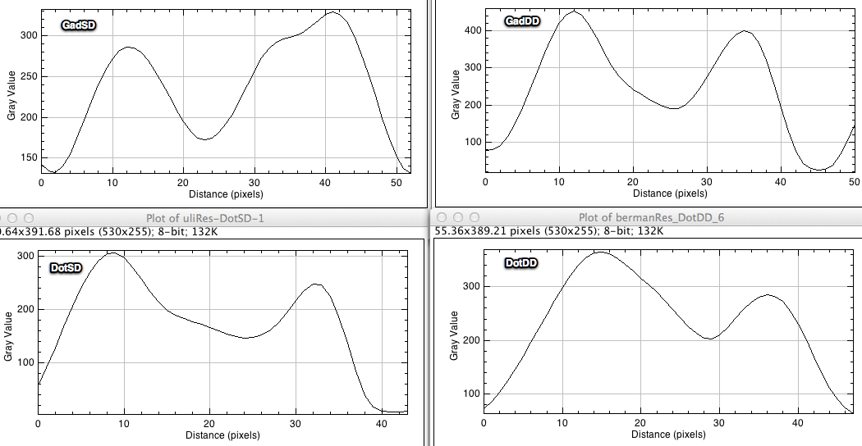


Slide 21


Slide 22
X Y
0 66.500
1 95.436
2 136.534
3 187.666
4 242.821
5 295.486
6 339.760
7 370.213
8 385.740
9 388.243
10 380.429
11 365.176
12 344.480
13 319.780
14 291.676
15 260.166
16 225.784
17 189.230
18 153.010
19 121.196
20 98.345
21 89.034
22 96.422
23 118.956
24 150.399
25 184.720
26 215.166
27 235.699
28 244.372
29 241.240
30 227.436
31 203.736
32 170.932
33 132.230
34 91.524
35 54.081
36 23.439
37 4.875
X Y
0 21.000
1 46.870
2 94.241
3 156.250
4 223.889
5 288.269
6 340.167
7 373.398
8 387.889
9 383.375
10 360.370
11 322.699
12 277.667
13 235.190
14 202.019
15 185.250
16 188.111
17 207.106
18 235.000
19 266.736
20 295.481
21 316.750
22 330.759
23 339.838
24 344.667
25 346.514
26 345.593
27 340.750
28 328.815
29 307.657
30 275.333
31 233.069
32 185.296
33 141.167
34 109.222
35 97.421
36 114.000

Slide 23


Slide 24


3) You can use Analyze → Plot Profile to create

Slide 25


Slide 26


Slide 27

X Y
0 45.000
1 35.298
2 26.161
3 18.906
4 13.874
5 11.042
6 9.504
7 9.758
8 11.576
9 14.917
10 21.803
11 34.778
12 54.336
13 79.644
14 110.233
15 143.769
16 176.433
17 204.958
18 227.595
19 243.152
20 252.545
21 255.669
22 255.370
23 254.796
24 258.003
25 268.287
26 288.099
27 318.165
28 353.750
29 388.930
30 414.449
31 419.839
32 407.253
33 375.667
34 328.343
35 277.030
36 225.149
37 178.937
38 142.427
39 115.479
40 98.674
41 88.485
42 81.573
43 76.712
44 70.370
45 61.901
46 51.908
47 41.071
48 33.011
49 27.245
50 24.255
51 21.253
52 18.424
53 15.387
54 13.835
55 14.741
56 18.162
57 22.879
58 25.646
59 24.389
60 17.592
61 8.609
62 4.512
63 1.488
64 9.109
65 26.131
66 51.667
67 82.339
68 115.345
69 146.234
70 172.712
71 194.114
72 207.760
73 215.055
74 219.807
75 222.088
76 225.581
77 233.259
78 244.818
79 261.859
80 280.696
81 297.339
82 308.499
83 308.860
84 298.066
85 279.211
86 253.466
87 224.909
88 198.037
89 175.197
90 155.149
91 137.332
92 120.525
93 104.664
94 87.802
95 70.184
96 53.386
97 38.496
98 25.798
99 16.000
X Y
0 78.000
1 91.866
2 108.896
3 128.504
4 151.350
5 175.923
6 201.154
7 226.186
8 246.879
9 263.213
10 274.870
11 279.349
12 279.614
13 278.005
14 275.887
15 274.740
16 273.744
17 273.140
18 270.532
19 262.496
20 250.341
21 233.774
22 212.123
23 188.221
24 164.023
25 143.442
26 129.036
27 117.645
28 109.419
29 103.136
30 96.584
31 89.312
32 81.883
33 75.088
34 69.990
35 65.966
36 62.320
37 56.005
38 48.870
39 41.329
40 33.720
41 28.571
42 25.695
43 25.000
44 24.462
45 24.431
46 23.829
47 23.117
48 22.730
49 23.228
50 24.454
51 25.106
52 28.761
53 35.195
54 46.534
55 64.392
56 87.910
57 117.047
58 151.302
59 188.919
60 226.735
61 263.411
62 296.844
63 324.593
64 347.704
65 362.937
66 370.291
67 372.023
68 366.830
69 353.676
70 334.524
71 308.289
72 275.322
73 237.692
74 198.302
75 159.744
76 124.721
77 96.442
78 73.545
79 54.388
80 42.176
81 30.686
82 19.298
83 10.009
84 3.476
85 0.000
86 1.990E-12

Slide 28

X Y
0 20.000
1 13.913
2 17.268
3 31.989
4 56.862
5 89.038
6 124.352
7 158.679
8 187.146
9 208.253
10 222.646
11 232.693
12 240.124
13 246.667
14 252.295
15 257.171
16 260.127
17 258.723
18 251.446
19 238.248
20 217.575
21 190.947
22 158.470
23 125.446
24 94.868
25 69.428
26 50.055
27 38.651
28 32.663
29 30.614
30 28.651
31 26.525
32 23.432
33 20.488
34 19.195
35 19.980
36 23.793
37 30.088
38 37.334
39 43.485
40 47.831
41 50.096
42 48.904
43 47.157
44 45.174
45 44.005
46 45.534
47 48.551
48 53.940
49 58.593
50 64.213
51 69.637
52 77.901
53 90.042
54 108.403
55 132.878
56 168.034
57 207.190
58 249.356
59 285.881
60 317.900
61 338.964
62 351.695
63 354.078
64 350.724
65 342.927
66 331.534
67 317.144
68 300.511
69 280.566
70 256.108
71 227.964
72 195.774
73 160.518
74 122.981
75 86.087
76 53.315
77 27.007
78 9.961
79 2.139
80 0.698
81 1.243
82 5.523
83 9.000

Slide 29


Slide 30

X Y
0 34.000
1 32.605
2 27.314
3 20.561
4 13.722
5 11.173
6 17.366
7 38.004
8 80.509
9 140.105
10 212.533
11 290.857
12 368.900
13 437.842
14 491.030
15 523.740
16 535.502
17 527.040
18 498.612
19 452.753
20 392.478
21 324.932
22 255.441
23 191.447
24 137.671
25 96.415
26 68.198
27 49.600
28 38.176
29 31.661
30 27.131
31 22.541
32 19.763
33 17.509
34 16.200
35 15.287
36 14.205
37 11.832
38 9.289
39 6.285
40 3.561
41 2.082
42 3.899
43 10.894
44 21.871
45 37.353
46 54.999
47 74.950
48 94.425
49 115.272
50 136.367
51 160.120
52 186.936
53 218.148
54 254.288
55 291.993
56 332.048
57 362.424
58 387.093
59 392.752
60 385.993
61 361.822
62 328.753
63 285.641
64 240.575
65 196.606
66 158.404
67 126.729
68 101.920
69 83.157
70 68.702
71 57.541
72 46.487
73 36.618
74 27.346
75 19.208
76 13.938
77 11.535
78 11.984
79 13.694
80 15.824
81 16.929
82 15.472
83 12.881
84 8.953
85 5.000

Slide 31

X Y
0 22.000
1 18.259
2 18.594
3 25.226
4 37.094
5 53.613
6 72.251
7 92.341
8 112.013
9 131.080
10 149.000
11 166.120
12 180.995
13 194.515
14 204.860
15 212.720
16 214.811
17 209.681
18 197.936
19 178.293
20 157.013
21 135.280
22 117.506
23 103.704
24 94.795
25 89.667
26 84.677
27 79.227
28 73.732
29 66.908
30 58.400
31 47.695
32 34.646
33 20.771
34 7.373
35 0.000
36 0.000
37 0.647
38 5.434
39 22.067
40 41.053
41 59.184
42 74.234
43 86.578
44 94.311
45 101.440
46 107.267
47 114.906
48 123.117
49 131.953
50 140.000
51 146.659
52 152.006
53 155.241
54 157.531
55 157.613
56 155.806
57 151.176
58 140.956
59 126.071
60 107.720
61 87.946
62 69.197
63 55.104
64 45.933
65 42.147
66 41.790
67 42.053
68 40.385
69 36.698
70 31.600
71 26.719
72 23.760
73 24.470
74 28.200
75 34.000

